Slide 1
API Security
Kristian Morarash

Slide 2
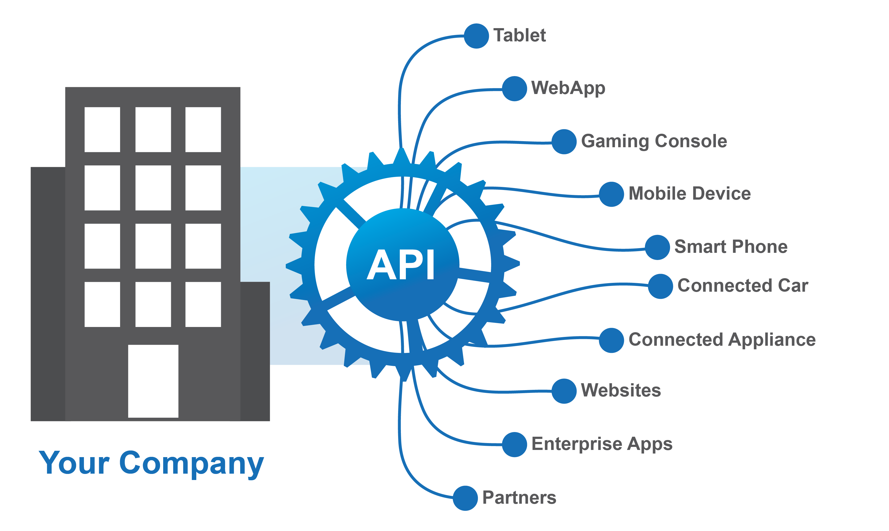
APIs Extend your Digital Ecosystems

Slide 3
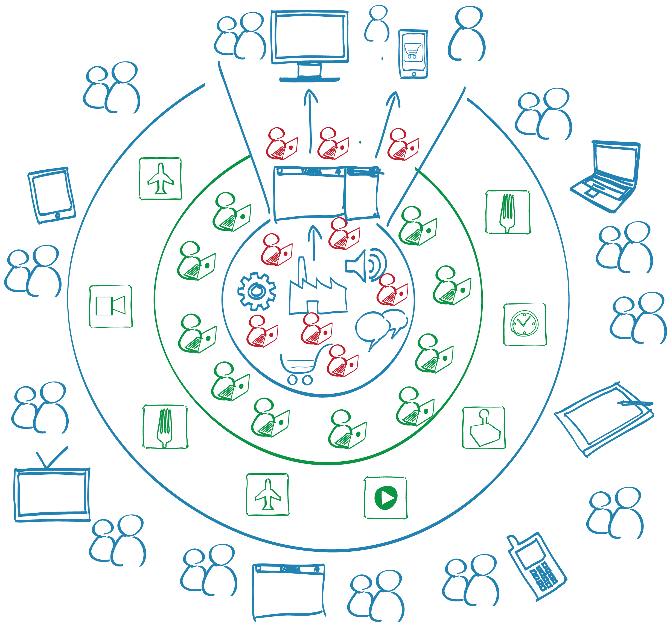
Leverage Developers & Partners Ecosystems
Tap into an extended eco-system of developers with APIs

Slide 4





Capture new Opportunities with APIs
Drive Innovation
Increase Reach
Support New Devices
Discover New Business Models
Increase Partner Network

Slide 5
API security

Slide 6
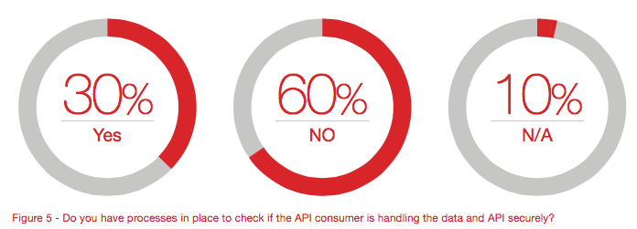
API Consumer Security?

Slide 7
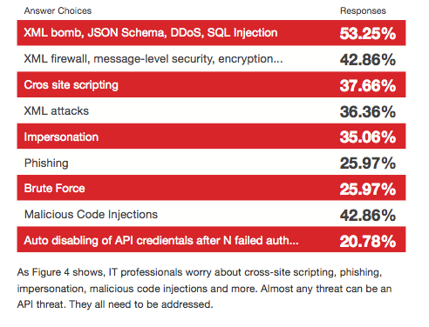
Major API Security Concerns

Slide 8
Evolution of SECURITY IN Digital CHAnnels

Slide 9


Client-Server/ Web Applications
Access locations and variability of operations were limited
No Programmatic Access
Security through network isolation
Limited Users

Slide 10

Web Services
The enterprise opened slightly with Web Services/SOAP
SSL/TLS, Certificate based, PKI, WS-Trust
Some B2B and Partners applications
Complex, but quite secure and flexible

Slide 11
WS-Security Policy
<wsp:Policy wsu:Id="WSS11SamlWithCertificates_policy">
<wsp:ExactlyOne>
<wsp:All>
<sp:SymmetricBinding>
<wsp:Policy>
<sp:ProtectionToken>
<wsp:Policy>
<sp:X509Token sp:IncludeToken="http://docs.oasis‑open.org/ws‑sx/ws-icy/200702/IncludeToken/Never”>
<wsp:Policy>
<sp:RequireThumbprintReference/>
<sp:RequireDerivedKeys wsp:Optional="true"/>
<sp:WssX509V3Token10/>
</wsp:Policy>
</sp:X509Token>
</wsp:Policy>
</sp:ProtectionToken>
<sp:AlgorithmSuite>
<wsp:Policy>
<sp:Basic256/>
</wsp:Policy>
</sp:AlgorithmSuite>
<sp:Layout>
<wsp:Policy>
<sp:Strict/>
</wsp:Policy>
</sp:Layout>
<sp:IncludeTimestamp/>
<sp:OnlySignEntireHeadersAndBody/>
</wsp:Policy>
</sp:SymmetricBinding>
<sp:SignedSupportingTokens>
<wsp:Policy>
<sp:SamlToken sp:IncludeToken= "http://docs.oasis-open.org/ws-sx/ws-securitypolicy/200702/IncludeToken/AlwaysToRecipient">
<wsp:Policy>
<sp:WssSamlV11Token11/>
</wsp:Policy>
</sp:SamlToken>
</wsp:Policy>
</sp:SignedSupportingTokens>
<sp:EndorsingSupportingTokens>
<wsp:Policy>
<sp:X509Token sp:IncludeToken=”AlwaysToRecipient">
<wsp:Policy>
<sp:WssX509V3Token11/>
</wsp:Policy>
</sp:X509Token>
</wsp:Policy>
</sp:EndorsingSupportingTokens>
<sp:Wss11>
<wsp:Policy>
<sp:MustSupportRefKeyIdentifier/>
<sp:MustSupportRefIssuerSerial/>
<sp:MustSupportRefThumbprint/>
<sp:MustSupportRefEncryptedKey/>
</wsp:Policy>
</sp:Wss11>
</wsp:All>
</wsp:ExactlyOne>
</wsp:Policy>

Slide 12


And then came APIs
Disrupting how and where information is accessed
Mobile and Social Apps don’t’ understand PKI, WS-Security, etc.
Focus on human readability, developer adoption

Slide 13
OWASP Top Ten
A1 – Injection
A2 – Broken authentication and session management
A3 – Cross-site scripting (XSS)
A4 – Insecure direct object references
A5 – Security misconfiguration
A6 – Sensitive data exposure
A7 – Missing function-level access control
A8 – Cross-site request forgery (CSRF)
A9 – Using components with known vulnerabilitites
A10 – Unvalidated redirects and forwards

Slide 14
PCI Compliance
APIs are now part of e-commerce
Card payments pass through API
The infrastructure underlying the API?

Slide 15
Securing APIS

Slide 16


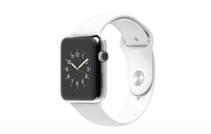





Securing APIs
5
Content Filtering
6
Rate Limiting
1
Authentication & Authorization
3
Message Security
2
App Key Validation/
Licensing
4
Threat Protection
Developers

Slide 17










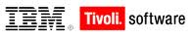



Authentication/Authorization/SSO
Control and restrict access to your APIs
Make it easy yet secure

Slide 18


Understanding OAuth
OAuth lets a person delegate constrained access from one app to another
Client App
Resource Owner
Resource Server
User

Slide 19
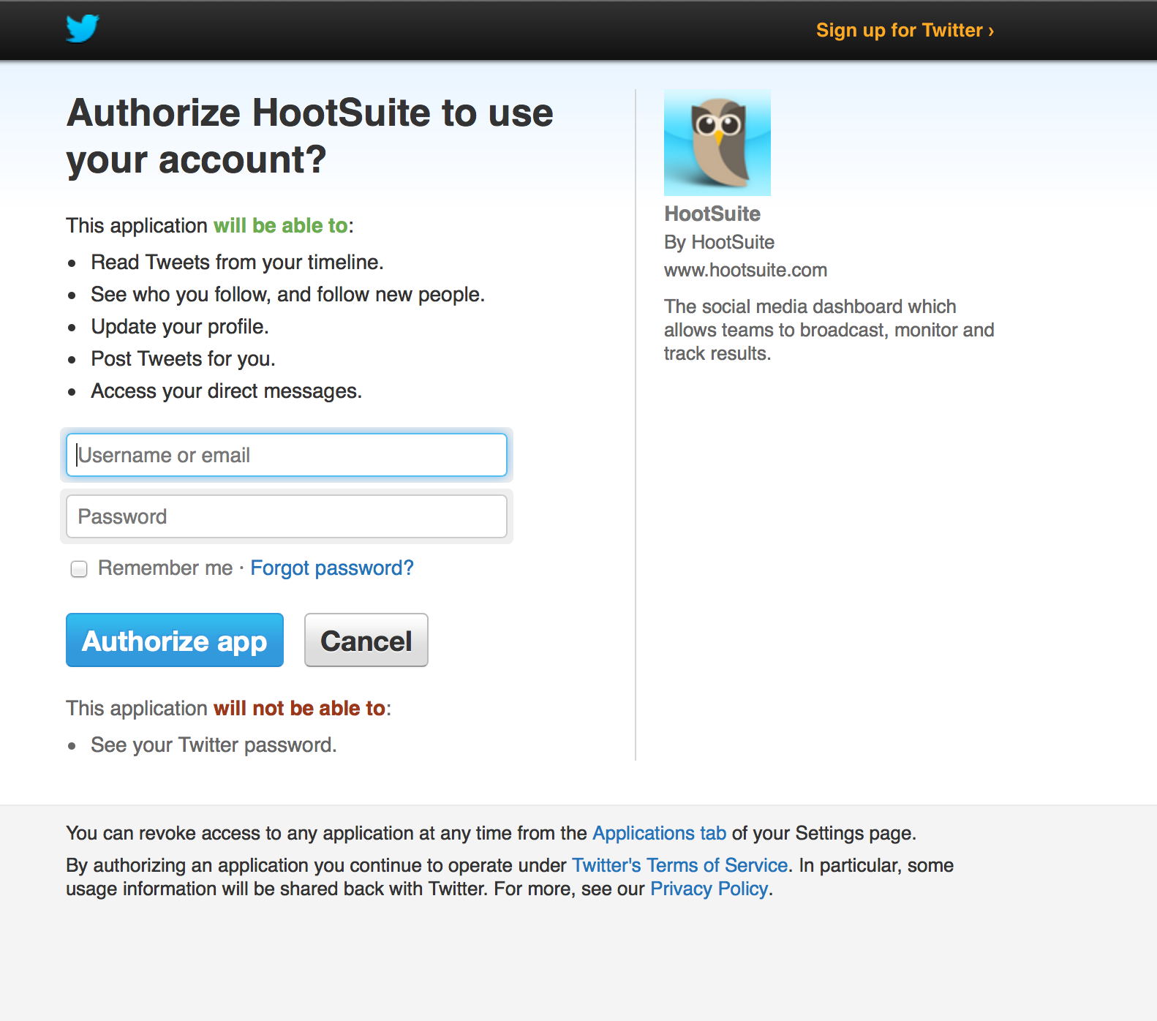
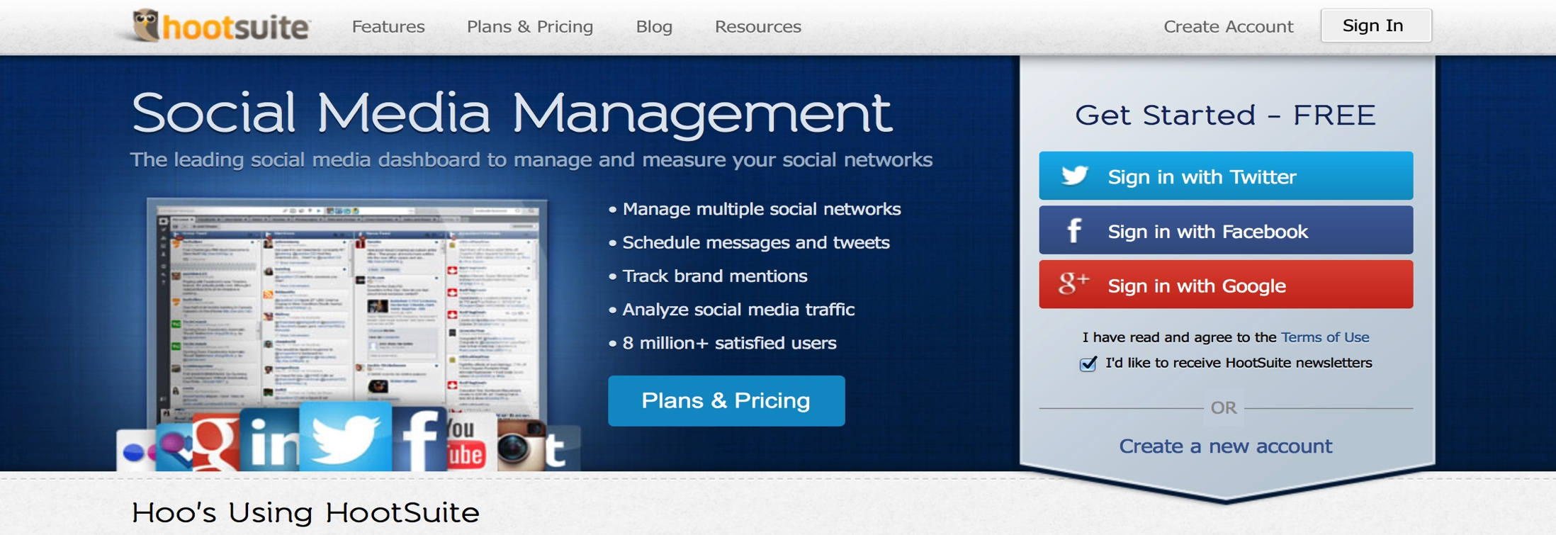
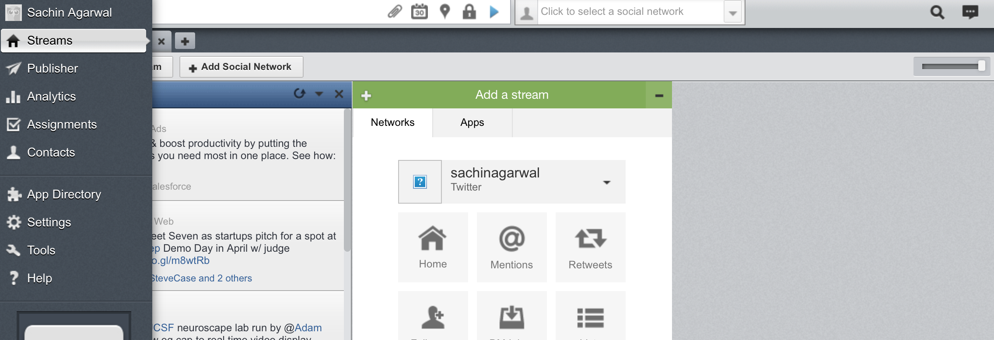
OAuth Flow

Slide 20
OAuth – You need
OAuth has become complex
OAuth Clients
Provisioning
Approval Flow
OAuth Server
Identity Integration
Token Validation
Token Issue/refresh
Token Mediation (SAML, LDAP etc)
QoS, Monitoring
Policy Management
API Proxying
Reporting
Analytics

Slide 21



Licensing
Package your APIs in different ways
Use API keys to restrict what the App can access
The licenses control:
OAuth Authorization Scopes
Document visibility
Quota policies

Slide 22







Message and Parameter Security
HTTP Parameter
http://apis.foo.com/resources/sample/foo?app_id=myid&app_key=mykey
Protect API Keys with HMAC – Hash-based Message Authentication Code
Message Security
Implement HTTPS
JWS/JWE, XML Encryption & Signature

Slide 23

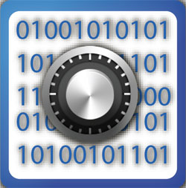
Threat Protection
Denial of Service
Injection Attacks
Detect and prevent SQL, JavaScript or XPath/XQuery injection attacks
Cross Site Scripting
Network address and range blacklists/whitelists
HTTP Parameter Stuffing

Slide 24

Content Threats
Provide a content firewall, protecting against malicious content
Validate message content including message headers, form and query parameters, XML and JSON data structures.
^{Policies for XML and JSON DoS}
Protection against viruses in attachments and other binary content via ICAP integration with leading anti-virus engines

Slide 25
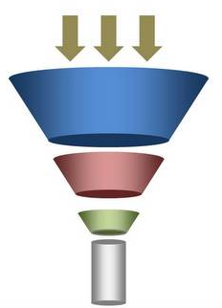
Quota Management/Rate Limiting
Restrict the number of calls an App can make
Apply controls based on context, affinity, segmentation etc.

Slide 26
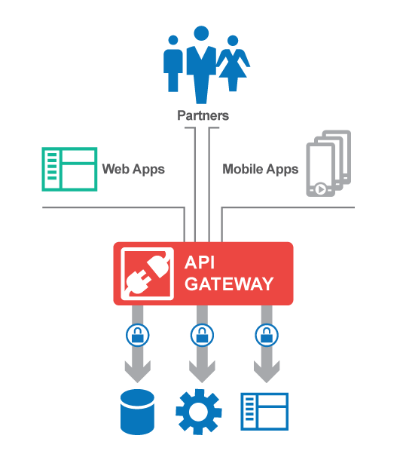











API Gateway
Gateway
Security
Authentication
Protection
IAM Integration
Encryption
Mediation
Quality of Service
Paging/Caching
Orchestration
Scripting

Slide 27
Managing and Automating Security

Slide 29

Govern Manage your Development/Deployment Process
API Initiatives need to integrated with your DevOps
Define and track multiple API and versions and the dependencies on those versions throughout the process.
Integrated with your development tools – IDE, Github, Chef, Puppet
Integrated with your deployment Tools
APIs
Lifecycle

Slide 30
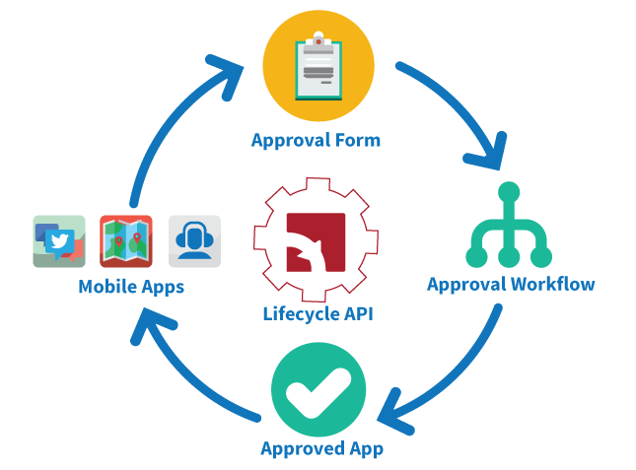
Automated Governance of Apps
User and App onboarding
Configurable forms to gather user/app info, collect agreements, etc.
Configurable role-based notifications and approvals
Mobile app based API SDLC approvals
Deliver approval requests to stakeholders on their preferred platform
DevOps automation

Slide 31
Thanks for your attention!

